Slide 1
Ease of doing business
01
01
Team Members:
Shubham Raj ( CE19B030) Talha Shamim (CS19B050)
Santosh Kumar (ME19B038) Rajendra kumar (CS19B034)
Vikas Meena (CE19B032 )

Slide 2
02
How do you plan to start a Business in some other country ?
Well ,for the starters you can look into their EODB Rankings
02

Slide 3
Economies are ranked on their ease of doing business, from 1–190.
A high ease of doing
business ranking means the regulatory environment is more conducive to the
starting and operation of a local firm.
The rankings are determined by sorting
the aggregate scores on
10 topics, each consisting of several indicators, giving equal weight to each
topic.
03
What is Ease of Doing Business ?
It is a joint initiative by the
Department for Promotion of Industry and Internal Trade (DPIIT) and the World Bank to improve the overall business
environment in the States.
03

Slide 4
What is Ease Of Doing Business Score ?
04
The ease of doing business score
helps assess the absolute level of regulatory performance over time.
It captures the gap of each economy
from the best regulatory performance observed on each of the indicators across all economies in the Doing
Business sample since 2005.
04

Slide 5
05
For example, an ease of doing business score of 75
in Doing
Business 2019 means
an economy was 25 percentage points away from the best regulatory performance
constructed across all economies and across time.
A score of 80 in Doing Business 2020 would
indicate the economy is improving
05

Slide 6
06
How
Do We Calculate EODB Score ?
Parameters :
Starting a business
Dealing with construction permits
Electricity Availability
Credit Availability
Property Registration
Protecting Minority investors
Paying Taxes
Trading Across Borders
Contracts Reinforcements
Resolving Insolvency
06

Slide 7
We Stand At a position of Rank 63 out of 190 countries ,with a score of 71.0
India being a jammed country still managed to achieve such rank and aims to be in the top 50 in the upcoming years
Where Do We Stand in EODB ?
07
07

Slide 8
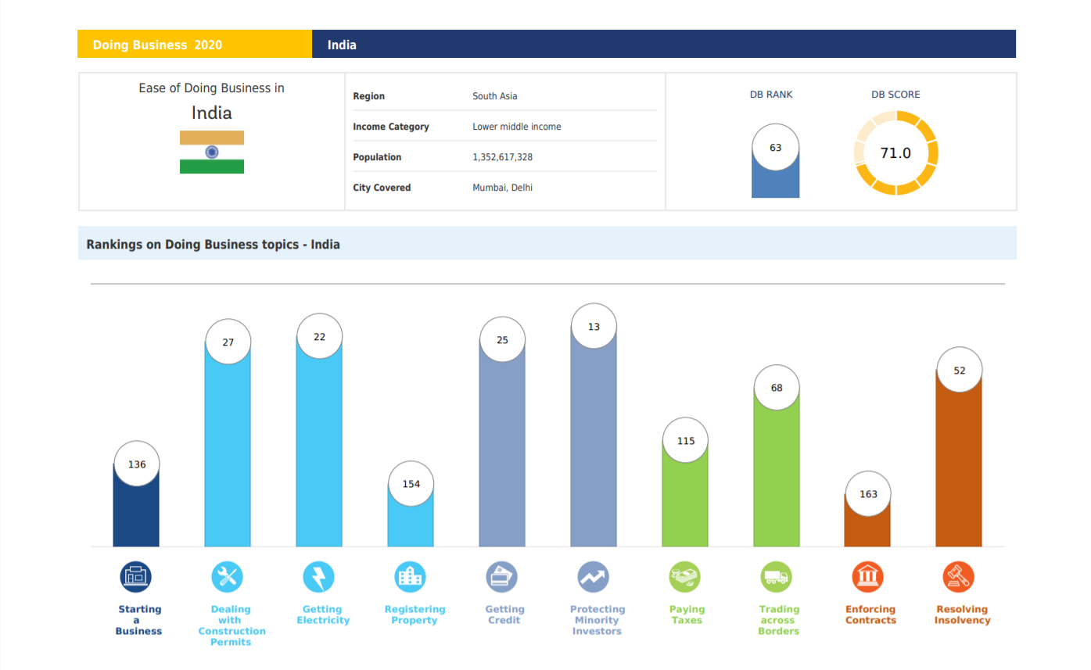
08

Slide 9
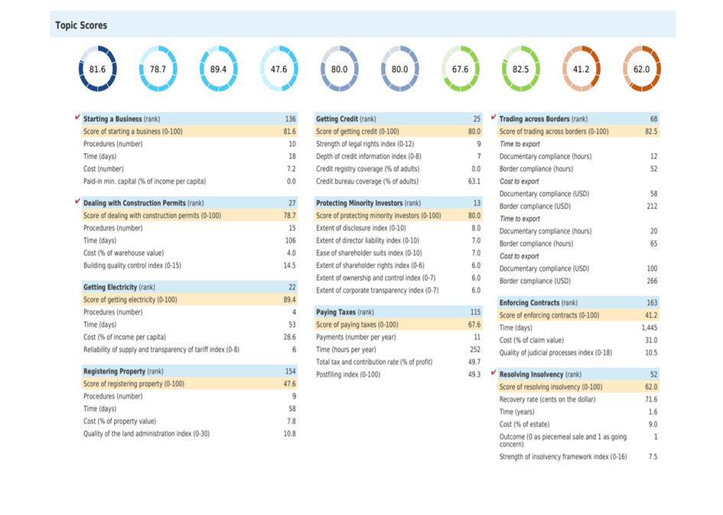
09

Slide 10
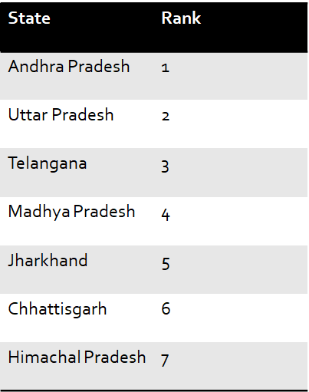
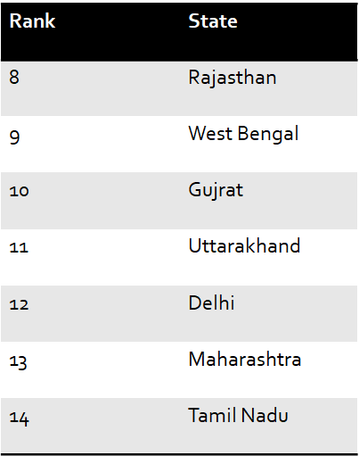
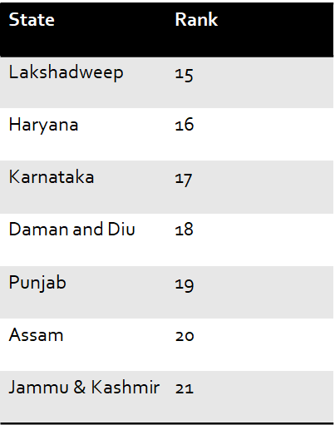
Ease of Doing Business in Various States
10
10

Slide 11
11
The Department for Promotion of Industry and Internal Trade (DPIIT), Ministry of Commerce and Industry
released the 4 edition of Ease of Doing Business Rankings based on the State Business Reform Action Plan (State BRAP).
Andhra Pradesh has topped the rankings followed
by Uttar Pradesh, Telangana, Madhya Pradesh and
Jharkhand.
11

